Slide 1
Energy
Renewable (Alternative Energy) Vs. Nonrenewable

Slide 2
You don’t know, what you do not know….that’s OK
This activity will help you identify what you don’t know, from what you do know regarding Renewable Vs. Nonrenewable energy resources.

Slide 3
For each slide do the following
Write – renewable or nonrenewable below pic
Try and answer the question regarding picture
AT THE END WE WILL REVIEW

Slide 4
RENEWABLE
This is energy from a source, that is not depleted or if depleted can be renewed, regrown, recycled or transformed back once used. Further these types of energy sources can be renewed on scales and time frames congruent with the human generational life span. Many are associated with having little or no detrimental effect on the environment.

Slide 5
NON-RENEWABLE
These energy forms come from sources that will run out or will not be replenished in our lifetimes—or even in many, many lifetimes. Many are associated with global warming or other types of environmental degradation.

Slide 6
NON-RENEWABLE
Oil Tar Sands
Coal Whaling
Natural Gas Clear cutting
Nuclear
Fracking

Slide 7
RENEWABLE
Geothermal Fisheries
Wind Forests
Solar w/ Enviromanagement
Hydroelectric or Hydropower
Other – fuel cell, biofuels, ethanol, tidal

Slide 8
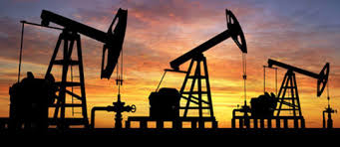
Renewable or nonrenewable
Do you know the name of these? ______________
What industry are they associated with? ______________

Slide 9
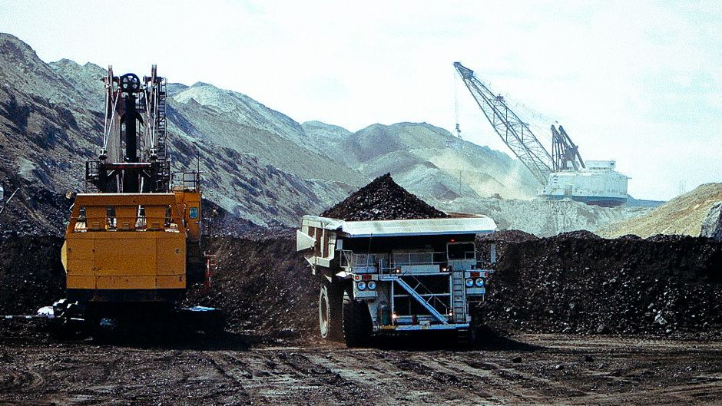
Renewable or nonrenewable
What is going on here? _________What industry is this? __________

Slide 10
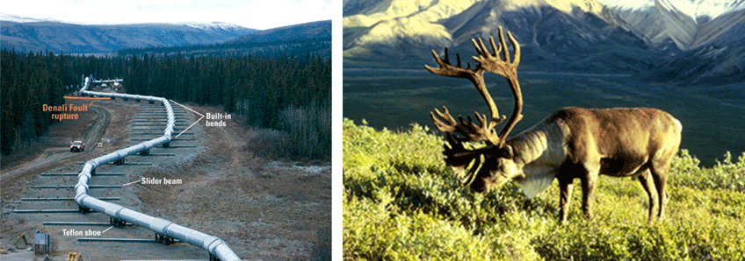
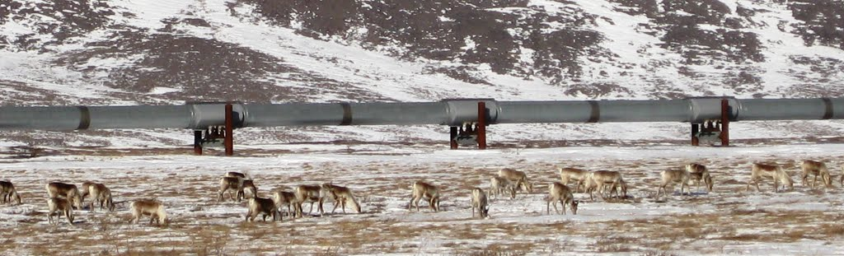
Renewable or nonrenewable
Where is this? _____________
What animal is in the foreground? _____________
What is that background? _____________

Slide 11
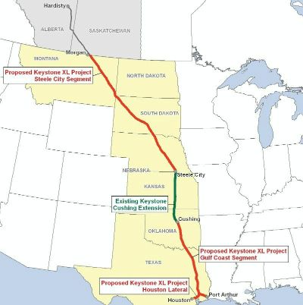
Renewable or nonrenewable
What is this a map of? _____________
(don’t say U.S. & Canada)
What do you know about this? ________________________________________________________________________________________________________________________

Slide 12
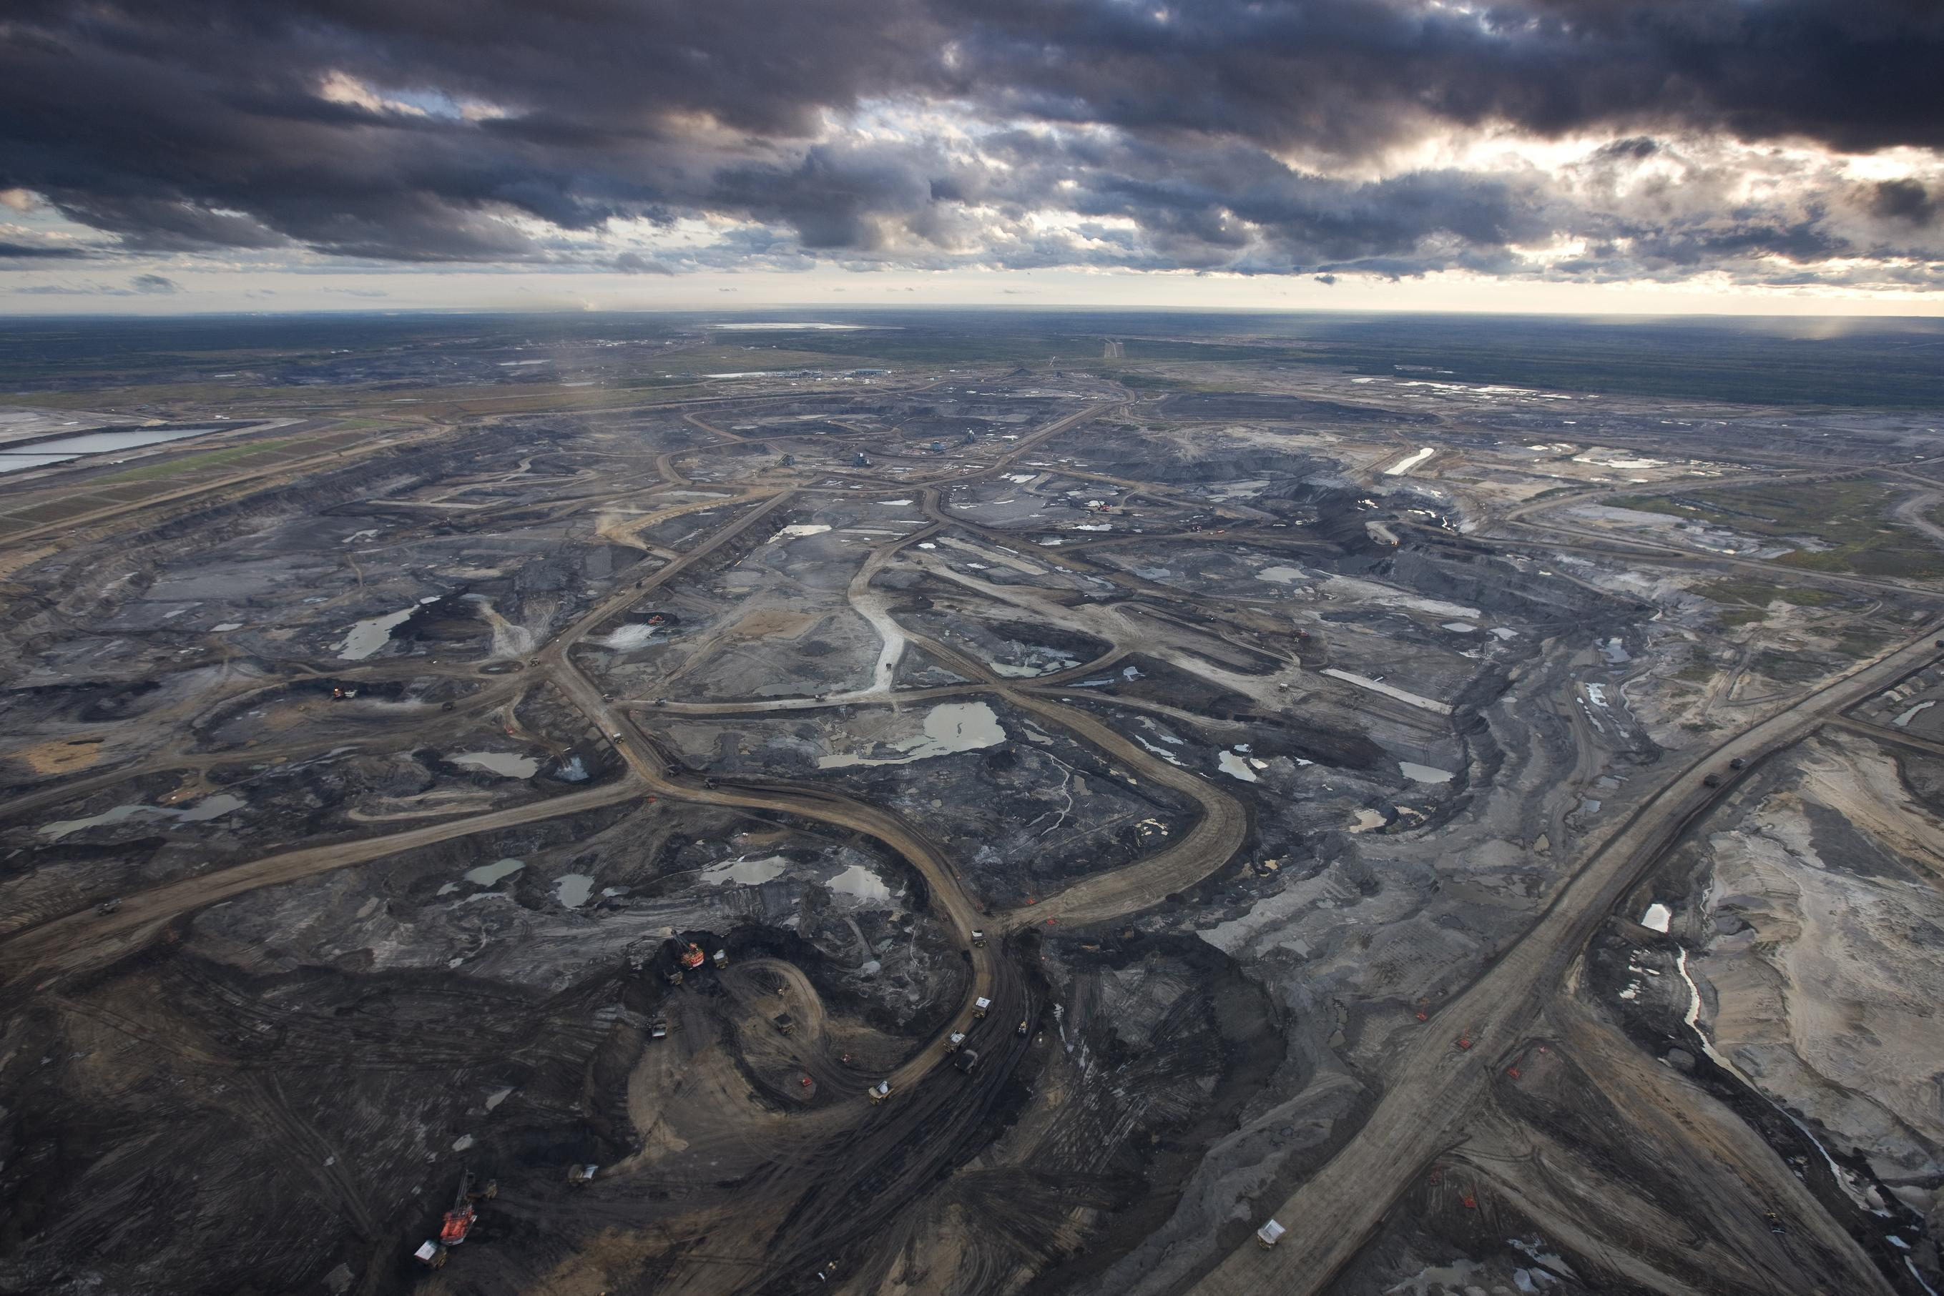
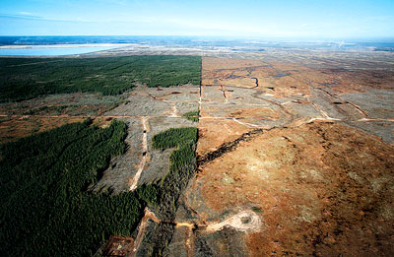
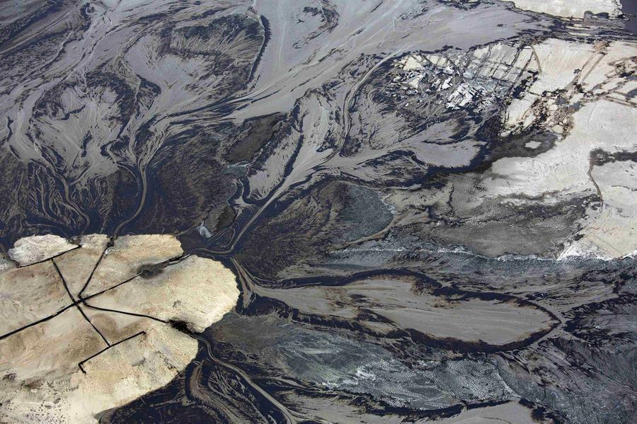
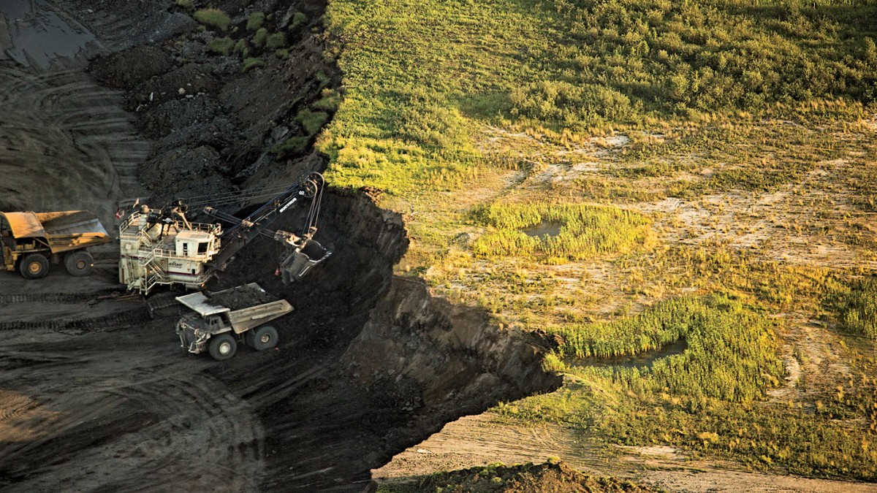
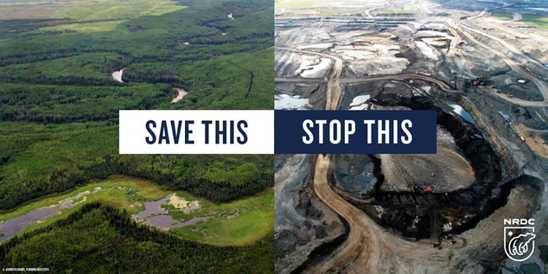
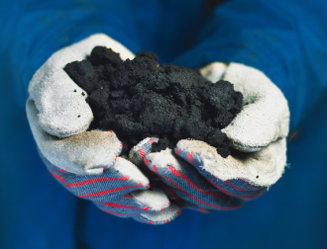
Renewable or nonrenewable
Where is this? _____________ What are they mining? ____________

Slide 13
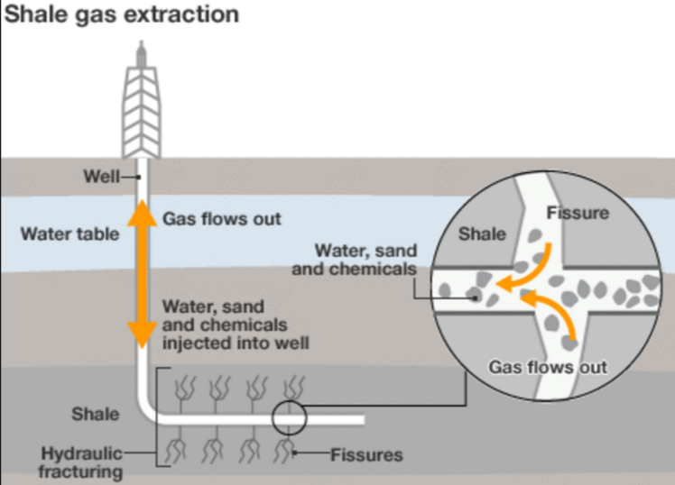
Renewable or nonrenewable
What is this called? ___________________

Slide 14
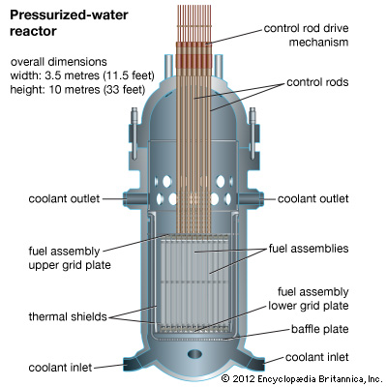
Renewable or nonrenewable
What type of power plant is this utilized in?
__________________
Does it go by any other names? ________________________
What type of energy is this? ________________________
7

Slide 15
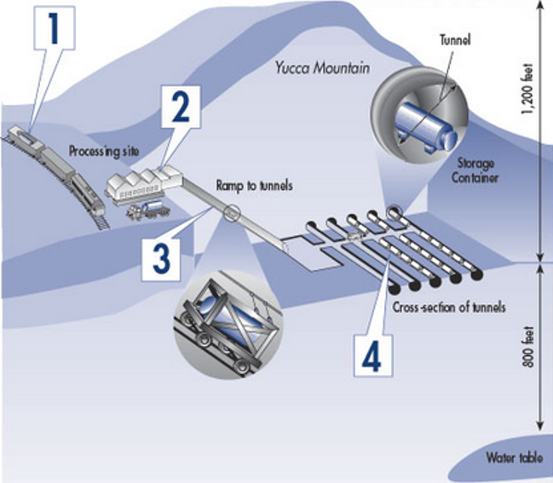
Renewable or nonrenewable
What is Yucca Mountain used for?
__________________
What is it that the federal government is proposing storing here?
__________________
8

Slide 16
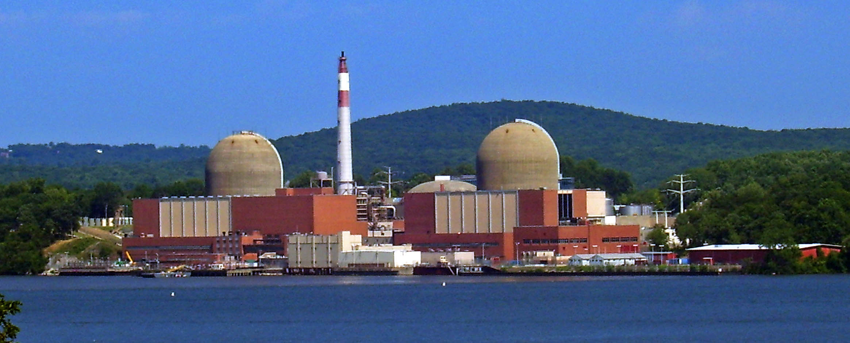
Renewable or nonrenewable
What is this? ____________ Where is it? ________________

Slide 17
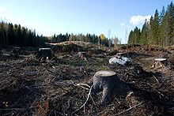
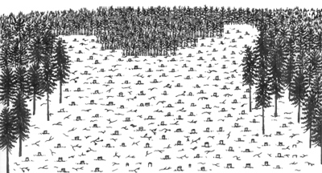
Renewable or nonrenewable ?
What is this called? __________________
10

Slide 18
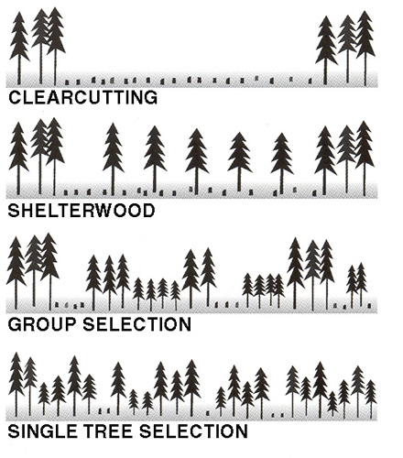
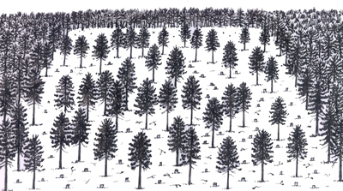
Renewable or nonrenewable ?
What is depicted in the below image? __________________
11

Slide 19
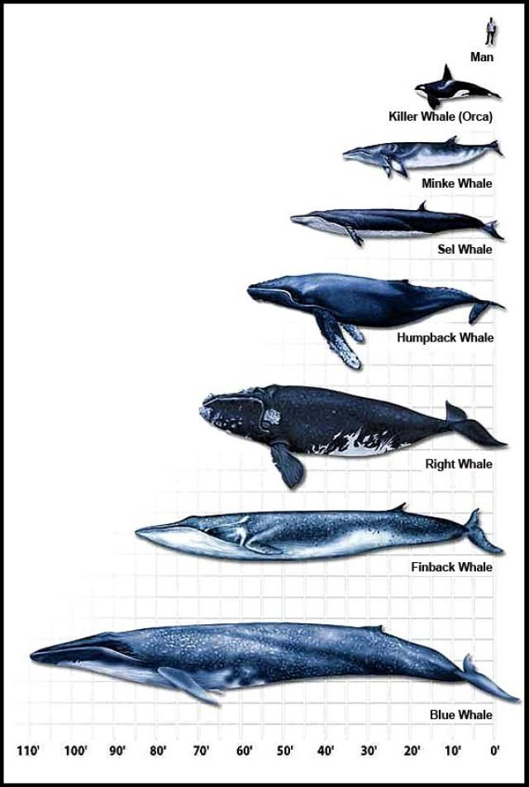
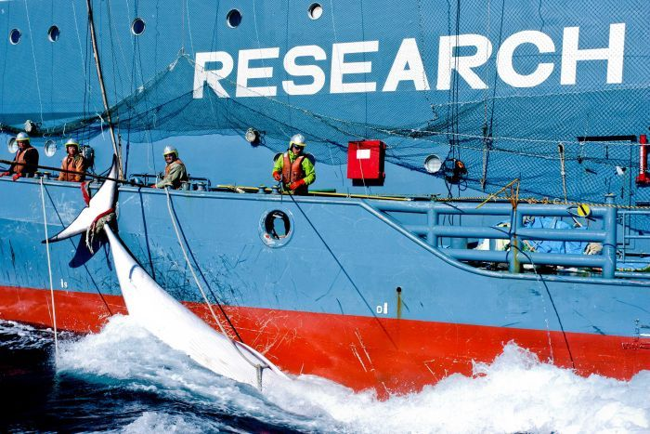
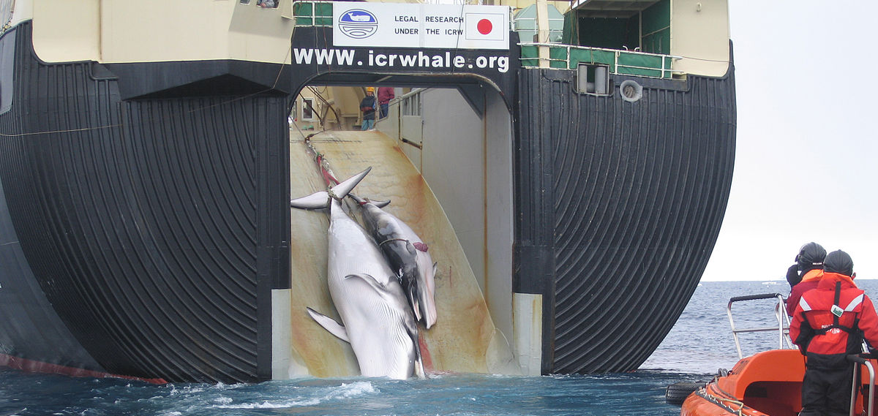
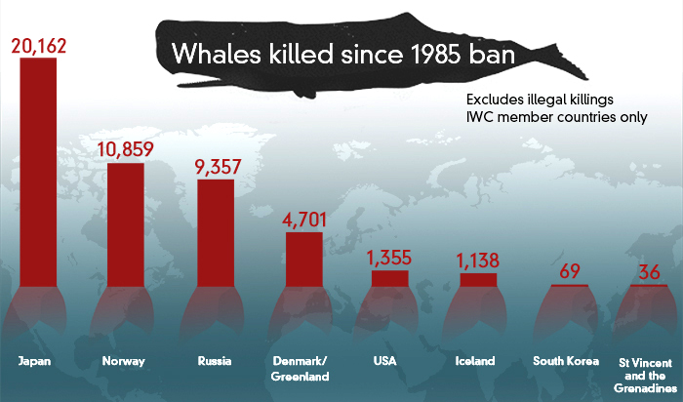
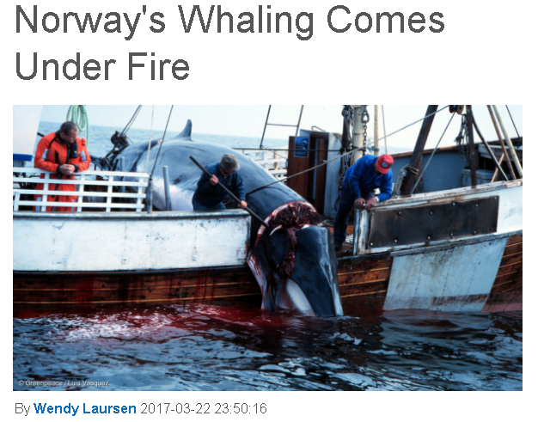
Renewable or nonrenewable ?
What is practice referred to as? __________________
Who is the leading killer of whales today?
__________________________
12

Slide 20
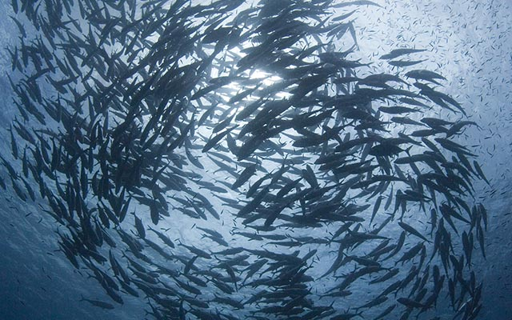
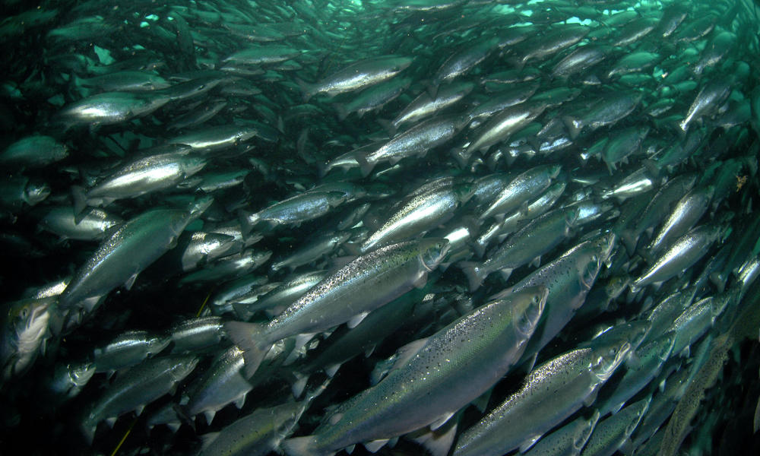
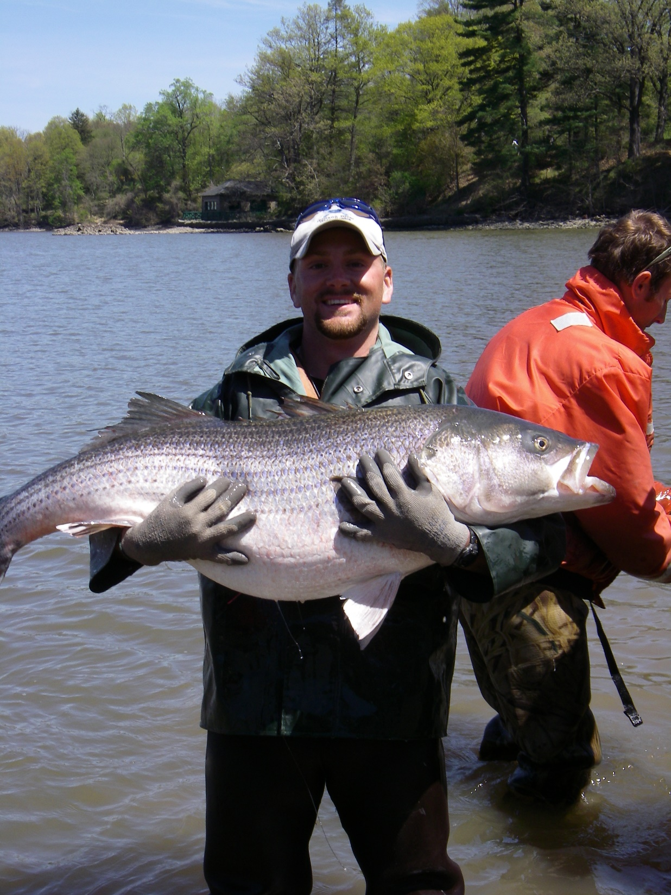
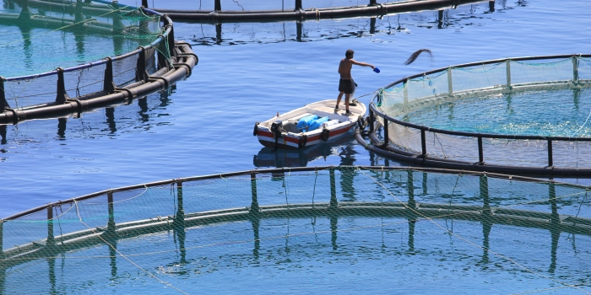
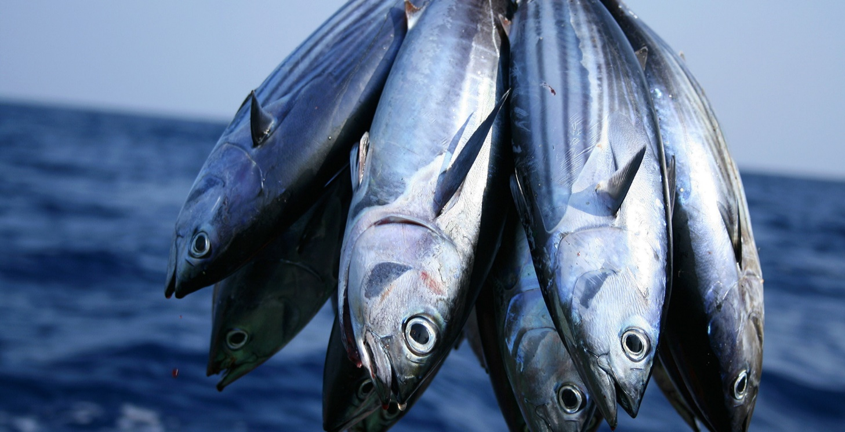
Renewable or nonrenewable ?
What is this natural resource referred to as? __________________
13

Slide 21
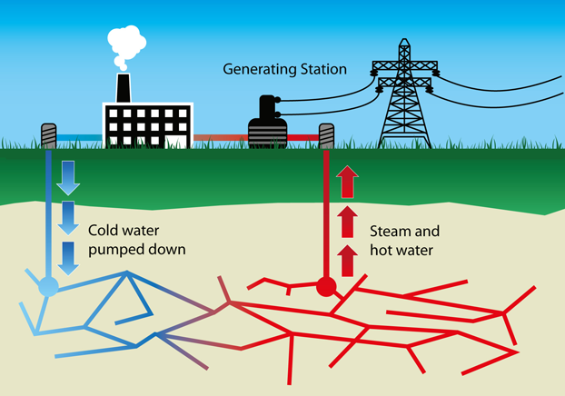
Renewable or nonrenewable
What industry is depicted here?
__________________
14

Slide 22
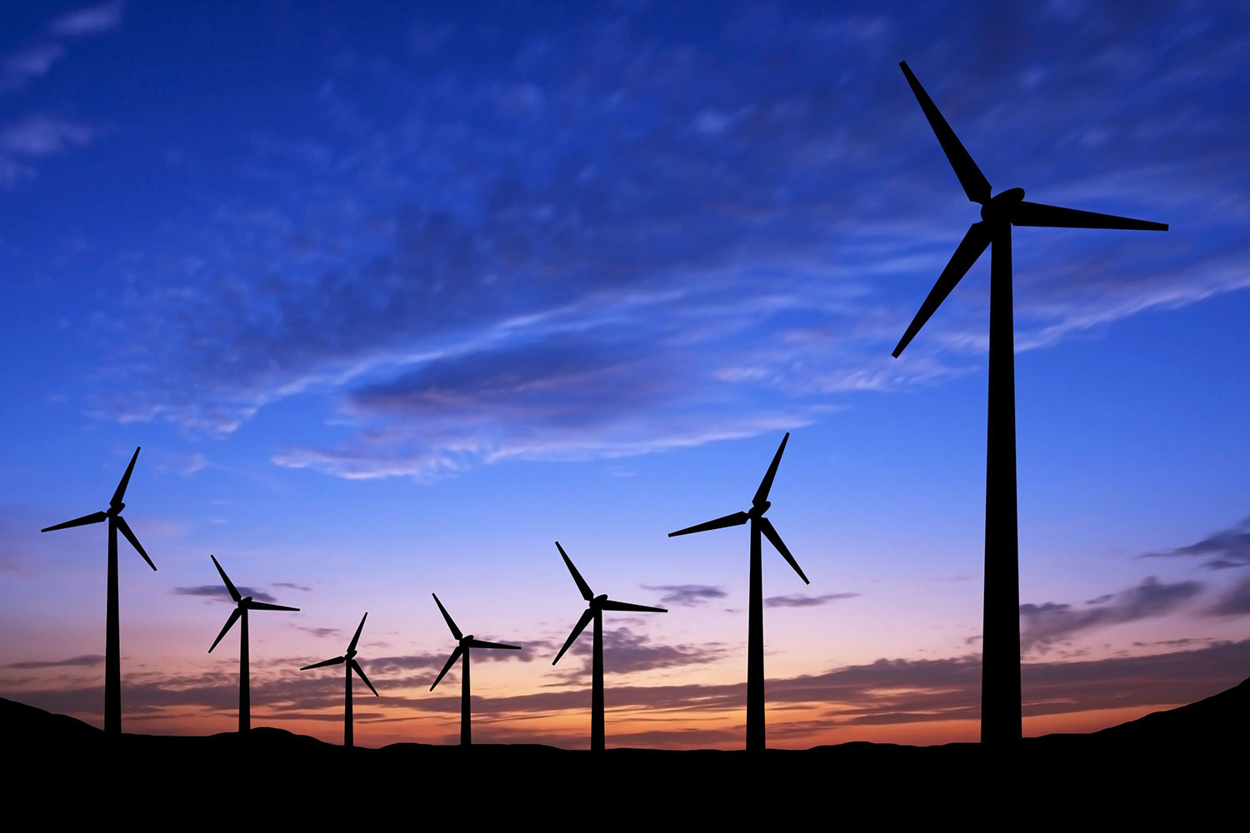
Renewable or nonrenewable
What are these called? __________________
15

Slide 23
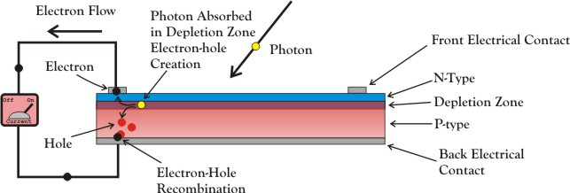
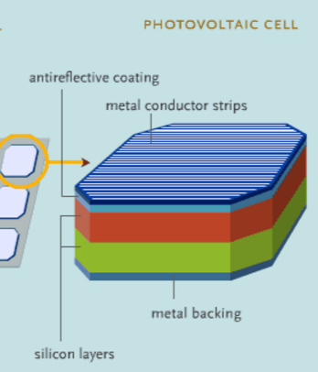
Renewable or nonrenewable
What are these used to make? __________________
16

Slide 24
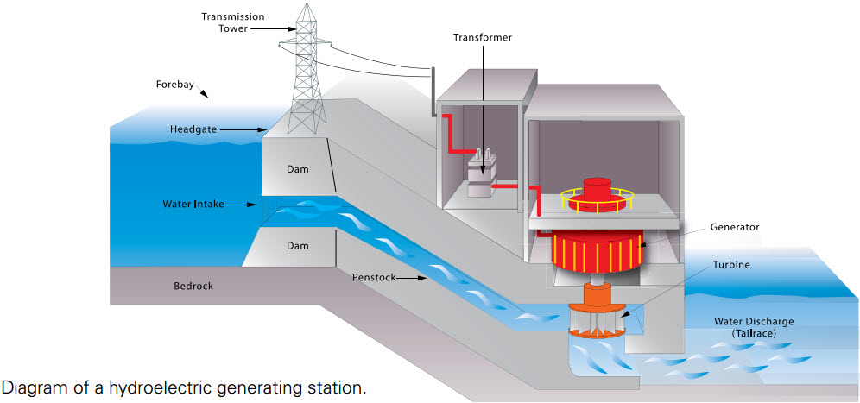
Renewable or nonrenewable
Do these go by another name? __________________
17

Slide 25
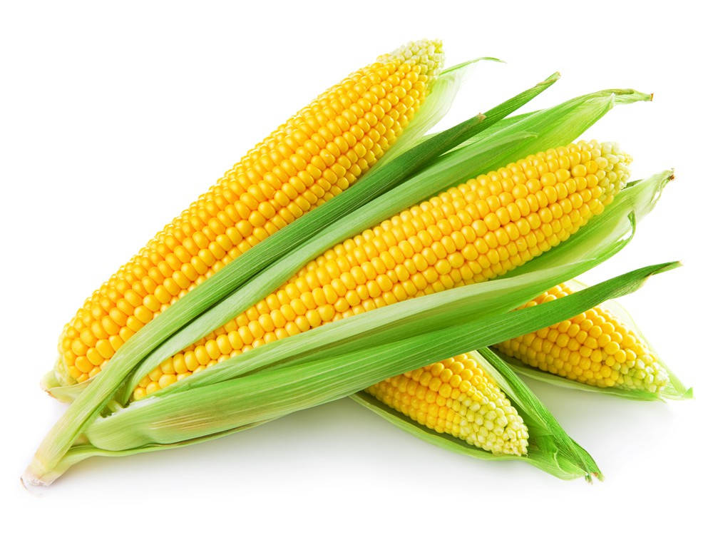
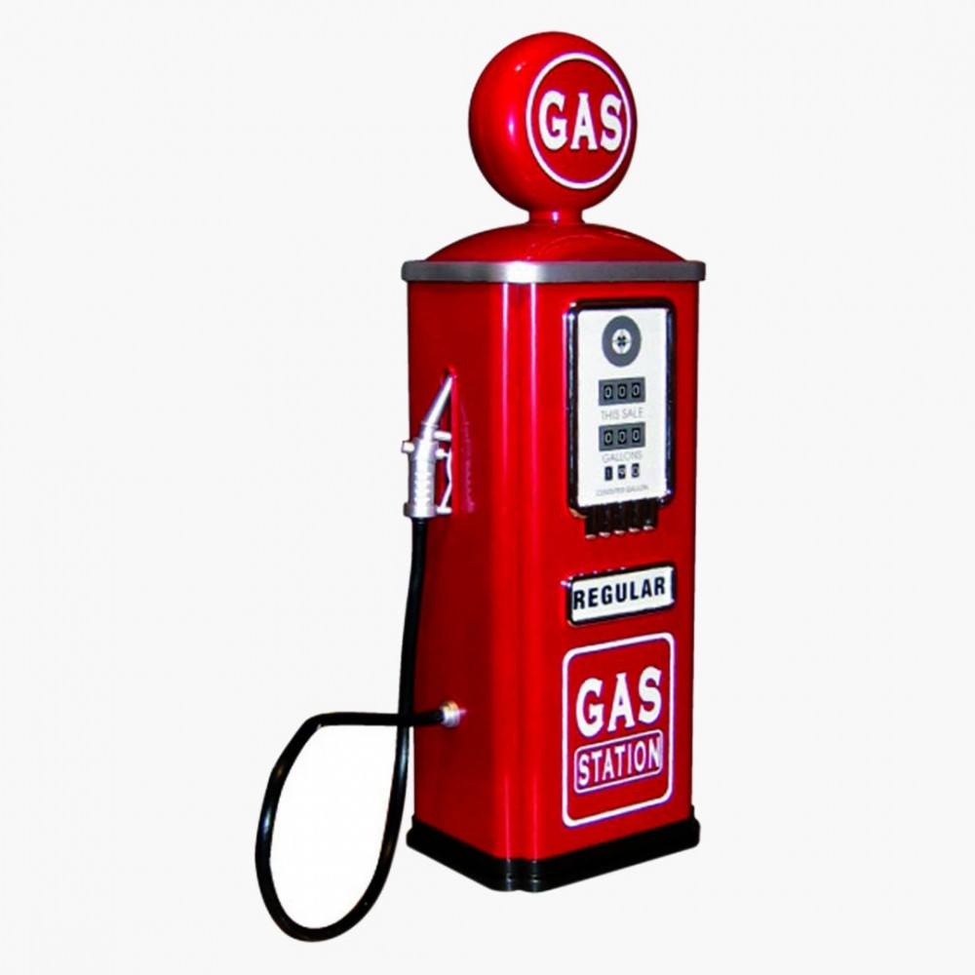

Renewable or nonrenewable – “the additive”
What additive product do we get from corn, that is added to gasoline? __________________
18

Slide 26
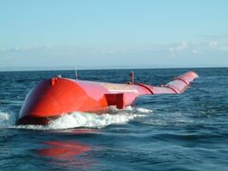
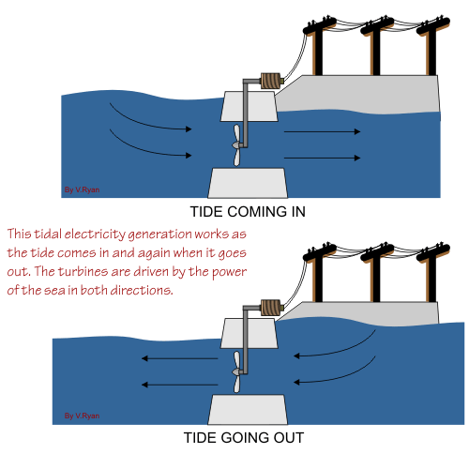
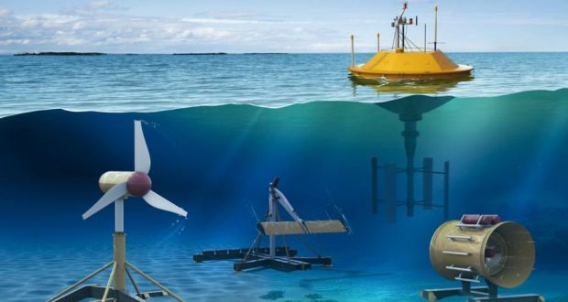
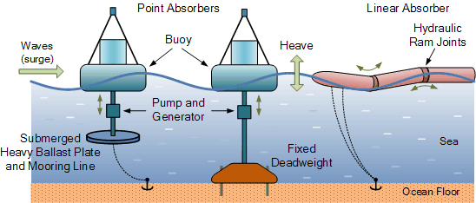
Renewable or nonrenewable
What form of energy are we using here? __________________ https://youtu.be/2_JSZaAgCUw
19

Slide 27
Renewable or nonrenewable
Do you know the name of these? Oil Derrick – (oil wellhead)
What industry are they associated with? Petroleum

Slide 28
Renewable or nonrenewable
What is going on here? Mining What industry is this? COAL__

Slide 29
Renewable or nonrenewable
Where is this? Alaska or Canada
What animal is in the foreground? Caribou or reindeer
What is that in the background? Oil or natural gas pipeline

Slide 30
Renewable or nonrenewable
What is this a map of?
Keystone Pipeline
(don’t say U.S. & Canada)
What do you know about this?
This is a proposed crude oil_ pipeline with far reaching__ economic and environmental implications.
4

Slide 31
Renewable or nonrenewable fossil fuel
Where is this? Alberta Canada What are they mining? Tar sands

Slide 32
Renewable or nonrenewable
What is this process called? Fracking

Slide 33
Renewable or
nonrenewable
What type of power plant is this utilized in?
Nuclear
Does it go by any other names
Nuclear reactor / Atomic Energy
7

Slide 34
Renewable or nonrenewable
What is Yucca Mountain used for?
Storing spent fuel rods
What is it that the federal government is proposing storing here?
(nuclear waste)
8

Slide 35
Renewable or nonrenewable
What is this? (Indian Point) Where is it? Hudson Valley
Nuclear Power Plant

Slide 36
Renewable or nonrenewable ?
What is this called? Clear cutting
Deforestation
10

Slide 37
Renewable or nonrenewable ?
What is depicted in the below image? Selective Cutting
11

Slide 38
Renewable or nonrenewable ?
What is practice referred to as? Whaling
Who is the leading killer of whales today?
Norway in the past Japan
12

Slide 39
Renewable or nonrenewable ?
What is this natural resource referred to as? Fisheries Management
Aquaculture
Fish Farming
13

Slide 40
Renewable or nonrenewable
What industry is depicted here?
Geothermal
14

Slide 41
Renewable or nonrenewable
What are these called? Wind turbines
15

Slide 42
Renewable or nonrenewable
What are these used to make? Solar panels
16

Slide 43
17
Renewable or nonrenewable
Do these go by another name? Hydropower plant - (dam)

Slide 44
Renewable nonrenewable
What additive product do we get from corn, that is added to gasoline? Ethanol
18

Slide 45
Renewable or nonrenewable
What form of energy are we using here?
Tidal or wave energy https://youtu.be/2_JSZaAgCUw
19

